Slide 1

ARRAYS & STRINGS IN

Slide 2
Arrays
An array is a group of like-typed variables that are referred to by a common name.
An array can be single-dimensional, multidimensional or jagged.
Single - Dimensional Array
To Declare an Array
type [] arrayname;
e.g. int[] myArray;
To create memory location
arrayname = new type[size];
e.g. myArray = new int[5];
To put values in the array
Arrayname[index]= value;
myArray[2] = “13”;

Slide 3
System.Array Class
Derived from System.Array Class.
Few Important Examples:
Length
Sort()
Reverse()
CopyTo()
Clear()
Gives the Length of the Array.
Sorts the elements in an 1-D array.
Reverse the contents of an 1-D array.
Copies elements from source array to destination array.
Sets all the elements to empty values.

Slide 4
ArrayList Class
supports operations such as sorting, removing and enumerating its contents.
Eg:
ArrayList cities = new ArrayList(30);
This will create a cities list with the capacity of 30 and by default it has size as 16.
To add elements to this list,
cities.Add(“Chennai”); cities.Add(“Mumbai”);

Slide 5
Multi Dimensional Arrays
To Declare Multi-Dimensional Array
type [,,] arrayname;
e.g. int[,,] myArray;
To create memory location
arrayname = new type[size, size, size];
e.g. myArray = new int[4,2,3];
To put values in the array
Arrayname[index]= value;
array5[2, 1] = 25;

Slide 6
Jagged Array
A jagged array is an array whose elements are arrays, possibly of different sizes. It is sometimes called an "array of arrays."
To Declare Jagged Array
type [,,] Arrayname;
e.g. int[][] jaggedArray;
To create memory location
Arrayname = new type[size, size, size];
e.g. jaggedArray = new int[3][];
To put values in the array
Arrayname[index][index]= value;
e.g. jaggedArray[0][1] = 77;

Slide 7









What Is String?
Strings are sequences of characters
Each character is a Unicode symbol
Represented by the string data type in C# (System.String)
Example:
string s = "Hello, C#";
s
H | e | l | l | o | , |  | C | #

Slide 8
Immutable
String objects are immutable.
All of the String methods and C# operators that appear to modify a string actually return the results in a new string object.
string s1 = “Hello”;
string s2 = s1;
s1 += “World”;
System.Console.WriteLine(s2);
//Output: Hello

Slide 9

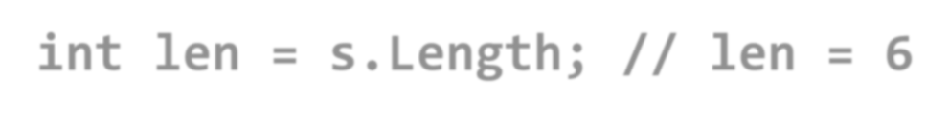















The System.String Class
String objects are like arrays of characters (char[])
Have fixed length (String.Length)
Elements can be accessed directly by index
The index is in the range [0...Length-1]
string s = "Hello!";
int len = s.Length; // len = 6
char ch = s[1]; // ch = 'e'
index = s[index] =
0 | 1 | 2 | 3 | 4 | 5
H | e | l | l | o | !

Slide 10
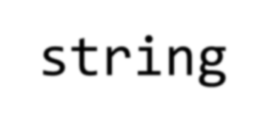
Declaring Strings
There are two ways of declaring string variables:
Using the C# keyword string
Using the .NET's fully qualified class name System.String
The following three declarations are equivalent
string str1; System.String str2; String str3;

Slide 11
Creating Strings
Not initialized variables has value of null
string s; // s is equal to null
Assigning a string literal
string s = "I am a string literal!";
Assigning from another string variable
string s2 = s;
Assigning from the result of string operation
string s = 42.ToString();

Slide 12
Reading and Printing Strings
Reading strings from the console
Use the method Console.ReadLine()
string s = Console.ReadLine();
Printing strings to the console
Use the methods Write() and WriteLine()
Console.Write("Please enter your name: "); string name = Console.ReadLine(); Console.Write("Hello, {0}! ", name); Console.WriteLine("Welcome to our party!");

Slide 13
Comparing Strings
A number of ways exist to compare two strings:
Dictionary-based string comparison
Case-insensitive
int result = string.Compare(str1, str2, true);
// result == 0 if str1 equals str2
// result < 0 if str1 if before str2
// result > 0 if str1 if after str2
Case-sensitive
Equality checking by operator ==
Performs case-sensitive compare
if (str1 == str2)
{
…
}
Using the case-sensitive Equals() method
Same effect like the operator ==
if (str1.Equals(str2))
{
…
}
string.Compare(str1, str2, false);

Slide 14
Concatenating Strings
There are two ways to combine strings:
Using the Concat() method
string str = String.Concat(str1, str2);
Using the + or the += operators
string str = str1 + str2 + str3; string str += str1;
Any object can be appended to string
string name = "Peter"; int age = 22;
string s = name + " " + age; // → "Peter 22"

Slide 15

Searching in Strings
Finding a character or substring within given string
First occurrence
IndexOf(string str)
First occurrence starting at given position
IndexOf(string str, int startIndex)
Last occurrence
LastIndexOf(string)

Slide 16




























Searching in Strings – Example
string str = "C# Programming Course";
int index = str.IndexOf("C#"); // index = 0
index = str.IndexOf("Course"); // index = 15
index = str.IndexOf("COURSE"); // index = -1
// IndexOf is case-sensetive. -1 means not found index = str.IndexOf("ram"); // index = 7
index = str.IndexOf("r"); // index = 4
index = str.IndexOf("r", 5); // index = 7 index = str.IndexOf("r", 8); // index = 18
index = s[index] =
0 | 1 | 2 | 3 | 4 | 5 | 6 | 7 | 8 | 9 | 10 | 11 | 12 | 13 | …
C | # |  | P | r | o | g | r | a | m | m | i | n | g | …

Slide 17








































Extracting Substrings
str.Substring(int startIndex, int length)
string filename = @"C:\Pics\fall2020.jpg"; string name = filename.Substring(8, 8);
// name is fall2020
str.Substring(int startIndex)
string filename = @"C:\Pics\fall2020.jpg"; string nameAndExtension = filename.Substring(8);
// nameAndExtension is fall2020.jpg
0 | 1 | 2 | 3 | 4 | 5 | 6 | 7 | 8 | 9 | 10 | 11 | 12 | 13 | 14 | 15 | 16 | 17 | 18 | 19
C | : | \ | P | i | c | s | \ | f | a | l | l | 2 | 0 | 2 | 0 | . | j | p | g

Slide 18
Splitting Strings
To split a string by given separator(s) use the following method:
string[] Split(params char[])
Example:
string listOfGames = “BattleField, Uncharted, COD, NFS”;
string[] games = listOfGames.Split(' ', ',' , '.'); Console.WriteLine("Available games are:");
foreach (string game in games)
{
Console.WriteLine(game);
}

Slide 19
Replacing and Deleting Substrings
Replace(string, string) – replaces all occurrences of given string with another
The result is new string (strings are immutable)
string course = “MCA + MBA + MSC”;
string replaced = courses.Replace("+", "and");
// MCA and MBA and MSC
Remove(index, length) – deletes part of a string and produces new string as result
string price = "$ 1234567";
string lowPrice = price.Remove(2, 3);
// $ 4567

Slide 20
Changing Character Casing
Using method ToLower()
string alpha = "aBcDeFg";
string lowerAlpha = alpha.ToLower(); // abcdefg Console.WriteLine(lowerAlpha);
Using method ToUpper()
string alpha = "aBcDeFg";
string upperAlpha = alpha.ToUpper(); // ABCDEFG Console.WriteLine(upperAlpha);

Slide 21
Trimming White Space
Using method Trim()
";
string s = " example of white space string clean = s.Trim(); Console.WriteLine(clean);
Using method Trim(chars)
string s = " \t\nHello!!! \n";
string clean = s.Trim(' ', ',' ,'!', '\n','\t');
Console.WriteLine(clean); // Hello
Using TrimStart() and TrimEnd()
string s = " C# ";
string clean = s.TrimStart(); // clean = "C# "

Slide 22
Method ToString()
All classes have public virtual method ToString()
Returns a human-readable, culture-sensitive string representing the object
Most .NET Framework types have own implementation of ToString()
int, float, bool, DateTime
int number = 5;
string s = "The number is " + number.ToString(); Console.WriteLine(s);
// The number is 5

Slide 23
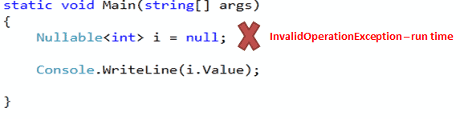
C# Nullable Types
Value type cannot be assigned a null value.
Example, int i = null will give you a compile time error.
Allow you to assign null to value type variables.
You can declare nullable types using Nullable<t> where T is a type.
Example: Nullable type
Nullable<int> i = null;
Nullable types are instances of System.Nullable<T> struct.
[Serializable]
public struct Nullable<T> where T : struct
{
public bool HasValue { get; }
public T Value { get; }
// other implementation
}
static void Main(string[] args)
{
Nullable< int > i = null;
Console.WriteLine(i.Value);
}

